Slide 1
Intangible Heritage Lists: Nominations and Procedures
NOM PPT 5.6
UNESCO
Intangible Cultural Heritage Section

Slide 2
In this presentation…
The Urgent Safeguarding List and the Representative list
Criteria for inscription
Procedures and timetables
Multinational nominations

Slide 3
The Lists of the Convention
Urgent Safeguarding List
Endangered ICH
Promotes safeguarding and provides assistance, including financial assistance
Recognizes value of endangered ICH for communities
Currently 16 elements
Representative List
Viable ICH
Raises visibility and awareness, while promoting cultural diversity and creativity
Encourages dialogue and understanding
Currently 213 elements

Slide 4
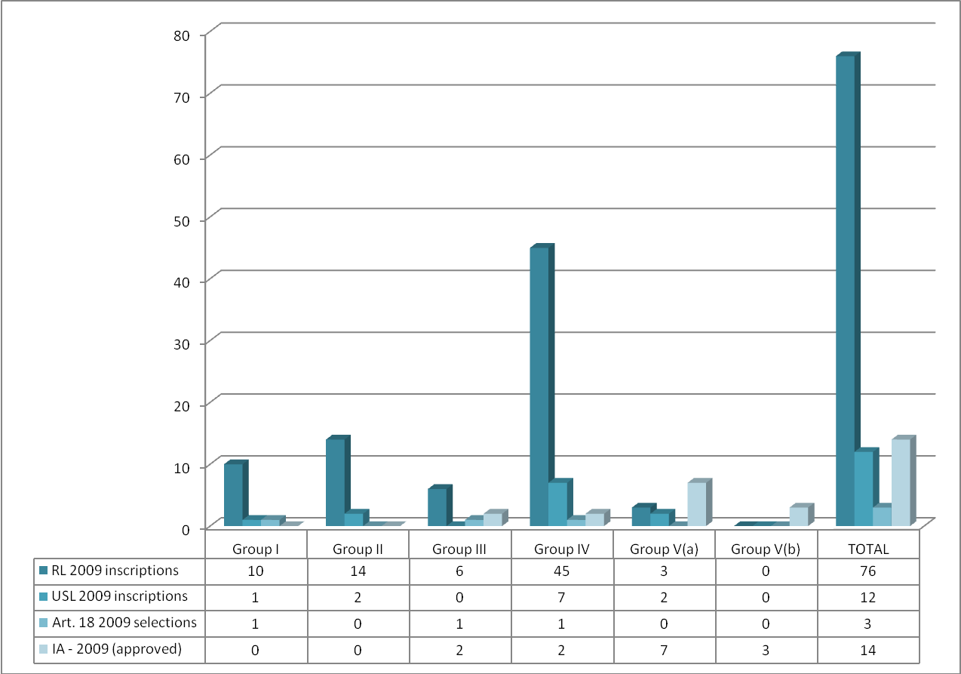
Regional imbalances, 2009

Slide 5
The Lists of the Convention: assistance
Urgent Safeguarding List
Financial assistance for preparing nominations (Form ICH 05)
Financing of safeguarding measures a priority of the ICH Fund (Form ICH 04)
Representative List
No such assistance
No priority but can be applied for (Form ICH 04)

Slide 6
Nominations to the Lists of the Convention:
Urgent Safeguarding List
States Parties nominate with community participation
Nomination Form ICH 01
Examination by Consultative Body; Committee evaluates and decides
Reporting cycle = 4 years
Preparatory assistance
Representative List
States Parties nominate with community participation
Nomination Form ICH 02
Examination by Subsidiary Body; Committee evaluates and decides
Reporting cycle = 6 years
No preparatory assistance

Slide 7
Which list?
Assessment of viability, threats and risks
Viability not impaired? Representative List
Viability impaired? Urgent Safeguarding List
Periodic reporting on viability
Transfers between lists

Slide 8
Evaluation criteria
Nominated elements have to meet the criteria in the Operational Directives.
6 criteria for USL
5 criteria for RL
Largely overlapping

Slide 9
Criteria common to both Lists
U1 and R1 Element complies with Convention’s definition of ICH;
U3 and R3 Safeguarding measures elaborated;
U4 and R4 Nomination prepared with participation and consent of community, group or individuals concerned;
U5 and R5 Element already included in an inventory.

Slide 10
Specific criteria – Urgent Safeguarding List
U2 The element should be in (a) urgent need or (b) extremely urgent need of safeguarding;
U6 In cases of extreme urgency, and accelerated inscription procedure, State(s) Party(ies) concerned are always consulted.

Slide 11
Specific criterion – Representative List
R2 Inscription contributes to visibility, awareness and dialogue, reflects cultural diversity worldwide and testifies to human creativity.

Slide 12
Examining Bodies
Subsidiary Body
Representative List Nominations
Consultative Body
USL & Article 18 Nominations

Slide 13
Nominations timetable
31 March: Nominations submitted
June to Sept: Nomination files assessed and completed
Dec-May: Nomination files examined
Sept-Nov: Nomination files evaluated and inscribed
YEAR 1
YEAR 2
Inscription decision

Slide 14
Multinational nominations
Much ICH is shared across borders
Collaboration aids safeguarding of shared heritage
The Convention encourages multinational nominations and requests for international assistance

Slide 15
Points to remember
A nomination file …
Is submitted by States Parties
With community participation and consent
Presents an element that complies with the Convention’s definition of ICH
Links to inventory and reports
Identifies viability, threats, risks and safeguarding measures
Is assessed by examination and eventually evaluated by Committee

